Slide 1
3. Bitcoin Transaction
Mastering Bitcoin - Programming the Open Blockchain, 2nd Ed., 2017

Slide 2
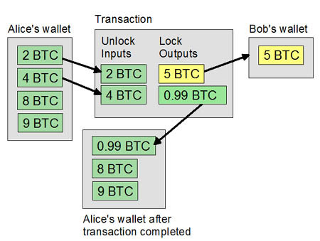
Introduction
Transactions are the most important part of the bitcoin system. Everything else in bitcoin is designed to ensure that transactions can be created, propagated on the network, validated, and finally added to the global ledger of transactions (the blockchain).
Transactions are data structures that encode the transfer of value between participants in the bitcoin system.
Each transaction is a public entry in bitcoin’s blockchain, the global double-entry bookkeeping ledger.

Slide 3
Transactions in Detail
(via a block explorer)

Slide 4
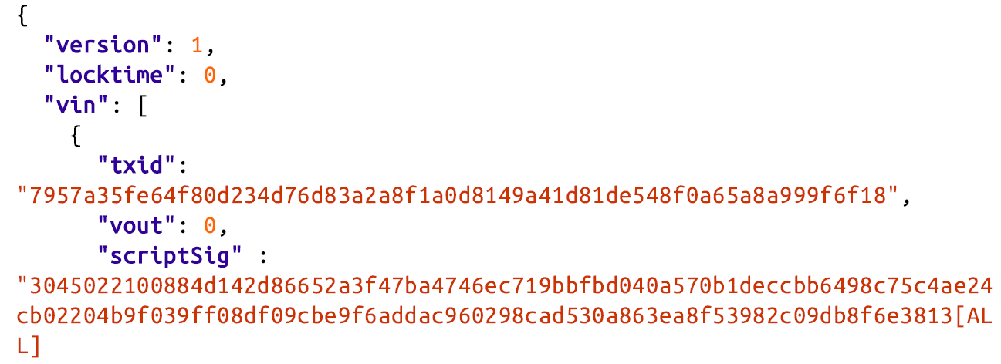
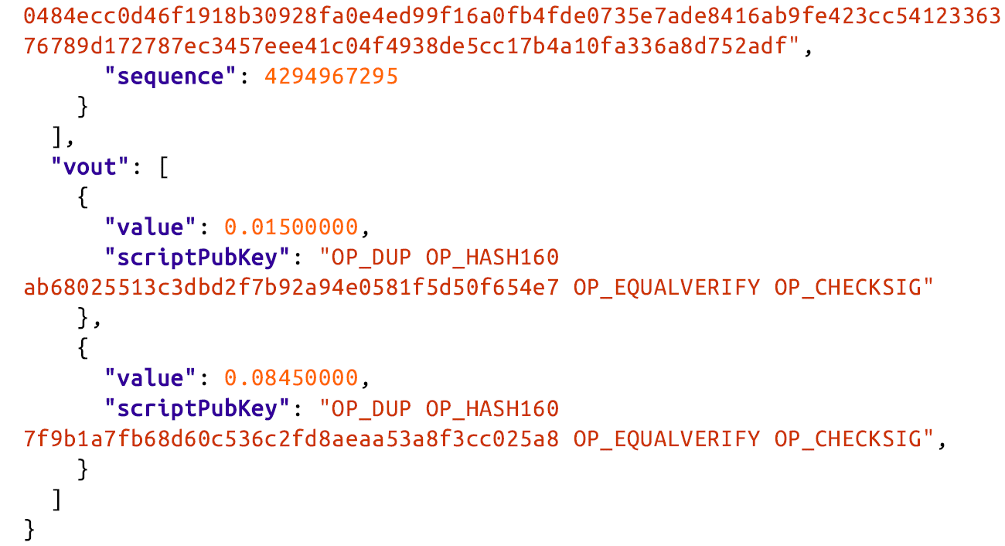
Transactions—Behind the Scenes
By Bitcoin Core’s command-line interface (getrawtransaction and decoderawtransaction)
In bitcoin, there are no coins, no senders, no recipients, no balances, no accounts, and no addresses. All those things are constructed at a higher level for the benefit of the user, to make things easier to understand.

Slide 5
Transaction Outputs and Inputs (1/5)
Fundamental building block of a bitcoin transaction is a transaction output. Transaction outputs are indivisible chunks of bitcoin currency, recorded on the blockchain, and recognized as valid by the entire network.
Bitcoin full nodes track all available and spendable outputs, known as unspent transaction outputs, or UTXO.
The collection of all UTXO is known as the UTXO set and numbers in the millions of UTXO.
The UTXO set grows as new UTXO is created and shrinks when UTXO is consumed. Every transaction represents a change (state transition) in the UTXO set.

Slide 6
Transaction Outputs and Inputs (2/5)
When we say that a user’s wallet has “received” bitcoin, what we mean is that the wallet has detected a UTXO that can be spent with one of the keys controlled by that wallet.
Thus, a user’s bitcoin “balance” is the sum of all UTXO that user’s wallet can spend and which may be scattered among hundreds of transactions and hundreds of blocks.
The concept of a balance is created by the wallet application. The wallet calculates the user’s balance by scanning the blockchain and aggregating the value of any UTXO the wallet can spend with the keys it controls.
Most wallets maintain a database or use a database service to store a quick reference set of all the UTXO they can spend with the keys they control.

Slide 7
Transaction Outputs and Inputs (3/5)
Bitcoin can be divided down to eight decimal places as satoshis. A transaction output can have an arbitrary (integer) value denominated as a multiple of satoshis. (1 BTC = 10⁸ satoshis)
Although an output can have any arbitrary value, once created it is indivisible. This is an important characteristic of outputs that needs to be emphasized: outputs are discrete and indivisible units of value, denominated in integer satoshis. An unspent output can only be consumed in its entirety by a transaction.
If an UTXO is larger than the desired value of a transaction, it must still be consumed in its entirety and change must be generated in the transaction.

Slide 8
Transaction Outputs and Inputs (4/5)
A bitcoin transaction must be created from a user’s UTXO in whatever denominations that user has available. The user’s wallet application will typically select from the user’s available UTXO to compose an amount greater than or equal to the desired transaction amount.
A transaction consumes previously recorded unspent transaction outputs and creates new transaction outputs that can be consumed by a future transaction. This way, chunks of bitcoin value move forward from owner to owner in a chain of transactions consuming and creating UTXO.

Slide 9
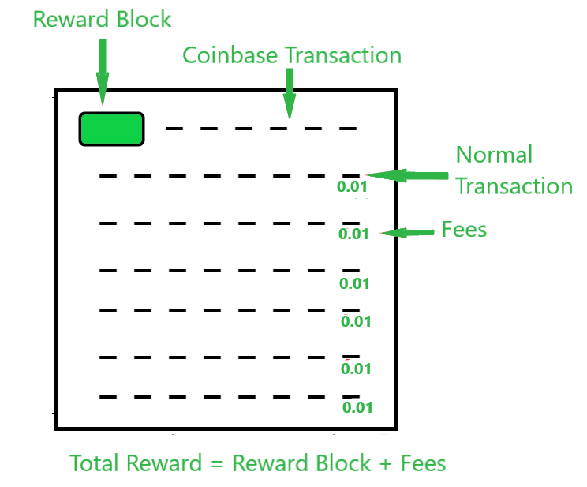
Transaction Outputs and Inputs (5/5)
The exception to the output and input chain is a special type of transaction called the coinbase transaction, which is the first transaction in each block.
This transaction is placed there by the “winning” miner and creates brand-new bitcoin payable to that miner as a reward for mining.
This special coinbase transaction does not consume UTXO; instead, it has a special type of input called the “coinbase.” This is how bitcoin’s money supply is created during the mining process.

Slide 10
Transaction Outputs (1/2)
Every bitcoin transaction creates outputs, which are recorded on the bitcoin ledger. Almost all of these outputs, with one exception (Data Recording Output “RETURN”) create spendable chunks of bitcoin called UTXO, which are then recognized by the whole network and available for the owner to spend in a future transaction.
UTXO are tracked by full-node bitcoin client in the UTXO set. New transactions consume (spend) one or more of these outputs from the UTXO set.
Transaction outputs consist of two parts:
An amount of bitcoin, denominated in satoshi.
A cryptographic puzzle (locking script, a witness script, or a scriptPubKey) that determines the conditions required to spend the output.

Slide 11
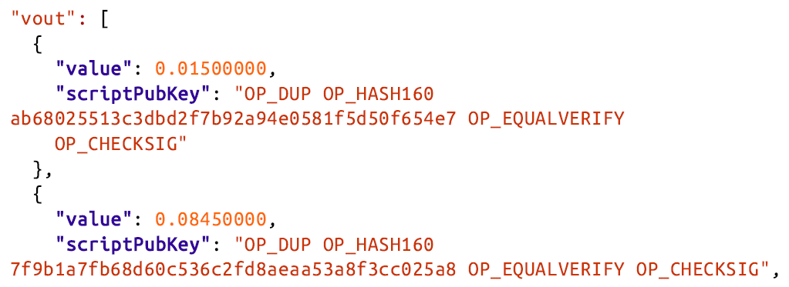
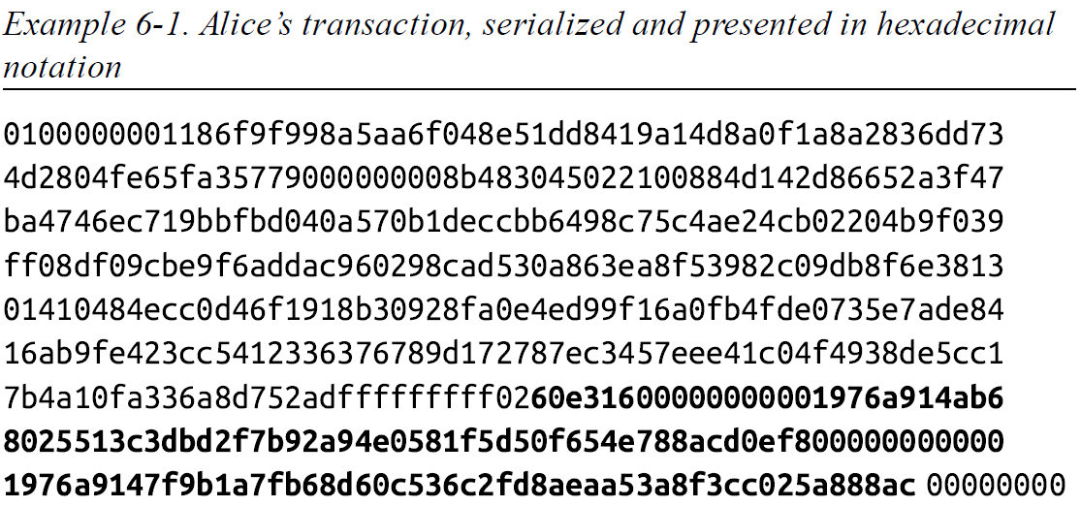
Transaction Outputs (2/2)
Serialization is the process of converting the internal representation of a data structure into a format that can be transmitted as a byte stream.
The value of 0.015 bitcoin is 1,500,000 satoshis. That’s 16 e3 60 in hexadecimal.
In the serialized transaction, the value 16 e3 60 is encoded in little endian (least-significant-byte-first) byte order, so it looks like 60 e3 16.

Slide 12
Transaction Inputs (1/3)
Transaction inputs identify (by reference) which UTXO will be consumed and provide proof of ownership through an unlocking script. For each UTXO that will be consumed to make this payment, the wallet creates one input pointing to the UTXO and unlocks it with an unlocking script.
Components of an input:
1. A pointer to an UTXO by reference to the transaction hash and sequence number where the UTXO is recorded in the blockchain
2. An unlocking script, which the wallet constructs in order to satisfy the spending conditions set in the UTXO. Most often, the unlocking script is a digital signature and public key proving ownership of the bitcoin.
3. A sequence number

Slide 13
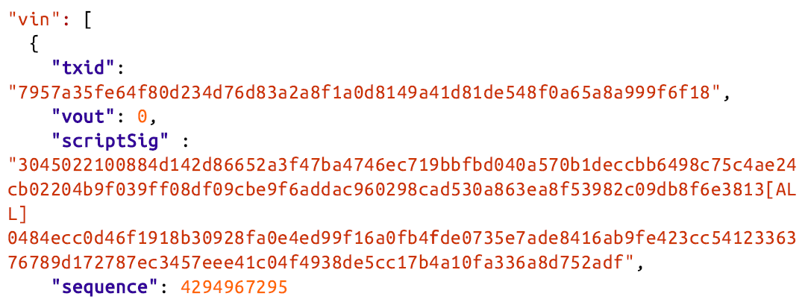
Transaction Inputs (2/3)
Transaction ID referencing the transaction that contains the UTXO being spent
An output index (vout), identifying which UTXO from that transaction is referenced (first one is zero)
which satisfies the conditions placed on the UTXO, unlocking it for spending
(nSequence Timelock)
Note: When transactions are serialized for transmission on the network, their inputs are encoded into a byte stream.

Slide 14
Transaction Inputs (3/3)
Looking just at the input you may have noticed that we don’t know anything about this UTXO, other than a reference to the transaction containing it.
We don’t know its value (in satoshi), and we don’t know the locking script that sets the conditions for spending it. To find this information, we must retrieve the referenced UTXO by retrieving the underlying transaction.
Notice that because the value of the input is not explicitly stated, we must also use the referenced UTXO in order to calculate the fees that will be paid in this transaction.
It’s not just Alice’s wallet that needs to retrieve UTXO referenced in the inputs. Once this transaction is broadcast to the network, every validating node will also need to retrieve the UTXO referenced in the transaction inputs in order to validate the transaction.

Slide 15
Transaction Fees (1/2)
Transaction fees compensate the bitcoin miners for securing the network, and also serve as a security mechanism by making it economically infeasible for attackers to flood the network with transactions.
Transaction fees are collected by the miner who mines the block that records the transaction on the blockchain.
Transaction fees are calculated based on the size of the transaction in kilobytes, not the value of the transaction in bitcoin.
Transaction fees are set based on market forces within the bitcoin network. Miners prioritize transactions based on many different criteria, including fees, and might even process transactions for free under certain circumstances.
Any bitcoin service that creates transactions, including wallets, exchanges, retail applications, etc., must implement dynamic fees.

Slide 16
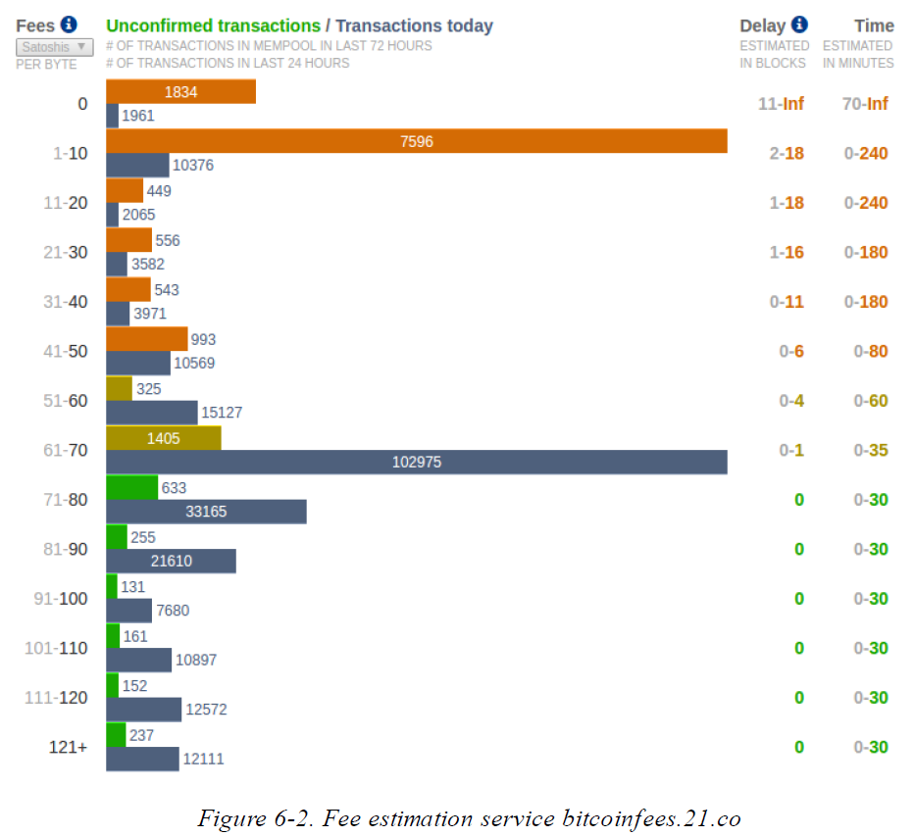
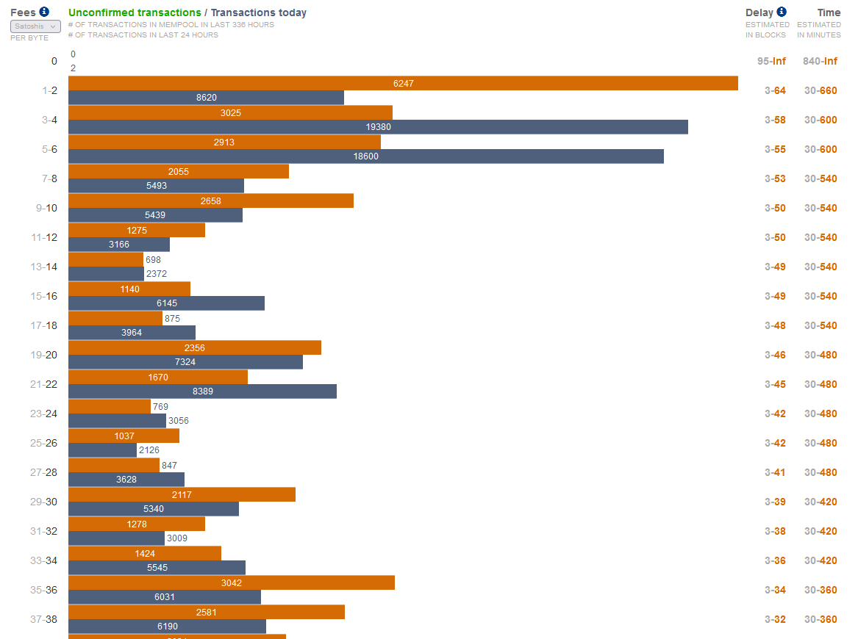
Transaction Fees (2/2)
Many wallet applications use third-party services for fee calculations, such as http://bitcoinfees.21.co
(As of 2022/3/7)
(From the book)
…

Slide 17
Transaction Scripts and Script Language
The bitcoin transaction script language contains many operators, but is deliberately limited in one important way—there are no loops or complex flow control capabilities other than conditional flow control.
This ensures that the language is not Turing Complete, meaning that scripts have limited complexity and predictable execution times.
The bitcoin transaction script language is stateless, in that there is no state prior to execution of the script, or state saved after execution of the script. All the information needed to execute a script is contained within the script.

Slide 18
Script Construction (Lock + Unlock) (1/2)
Bitcoin’s transaction validation engine relies on two types of scripts to validate transactions: a locking script and an unlocking script.
A locking script is a spending condition placed on an output: it specifies the conditions that must be met to spend the output in the future. Historically, the locking script was called a scriptPubKey, because it usually contained a public key or bitcoin address (public key hash).
An unlocking script is a script that “solves,” or satisfies, the conditions placed on an output by a locking script and allows the output to be spent. Unlocking scripts are part of every transaction input. Most of the time they contain a digital signature produced by the user’s wallet from his or her private key. Historically, the unlocking script was called scriptSig, because it usually contained a digital signature.

Slide 19
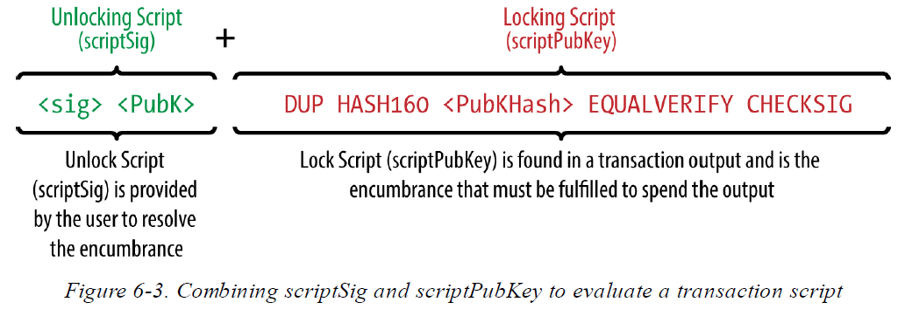
Script Construction (Lock + Unlock) (2/2)
Example of the unlocking and locking scripts for the most common type of bitcoin transaction (a payment to a public key hash)

Slide 20
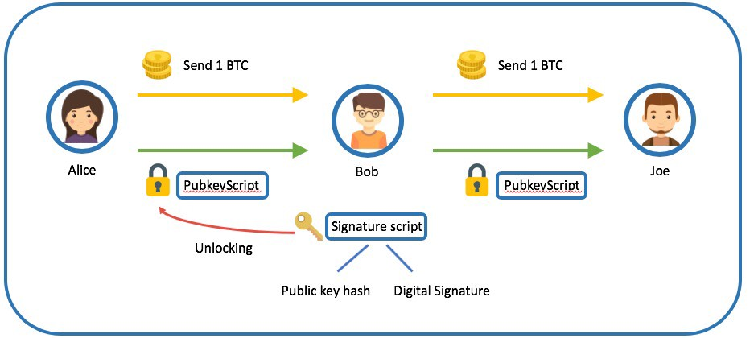
Pay-to-Public-Key-Hash (P2PKH) Script (1/4)
The vast majority of transactions processed on the bitcoin network spend outputs locked with a “P2PKH” script.
These outputs contain a locking script that locks the output to a public key hash, more commonly known as a bitcoin address.
An output locked by a P2PKH script can be unlocked (spent) by presenting a public key and a digital signature created by the corresponding private key.

Slide 21
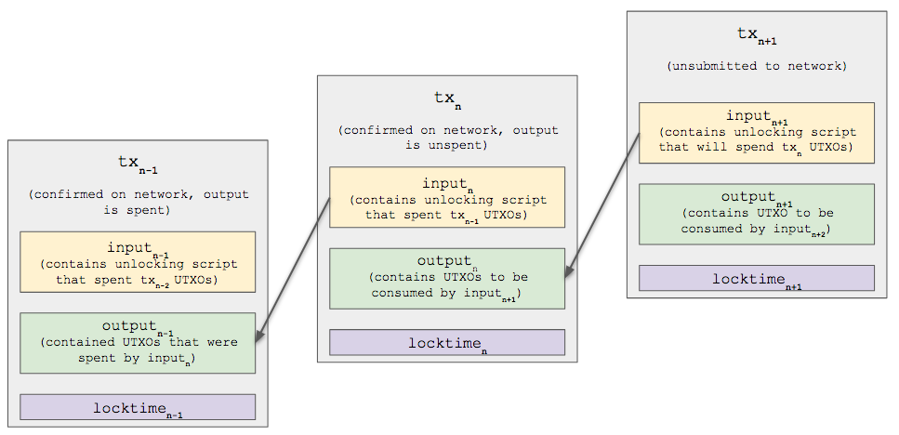
Pay-to-Public-Key-Hash (P2PKH) Script (2/4)

Slide 22


Pay-to-Public-Key-Hash (P2PKH) Script (3/4)
For example, let’s look at Alice’s payment to Bob’s Cafe. Alice made a payment of 0.015 bitcoin to the cafe’s bitcoin address. That transaction output would have a locking script of the form:
The locking script can be satisfied with an unlocking script of the form:
Two scripts together form the following combined validation script:
(Cafe Public Key Hash is equivalent to the bitcoin address of the café)
unlock
lock

Slide 23
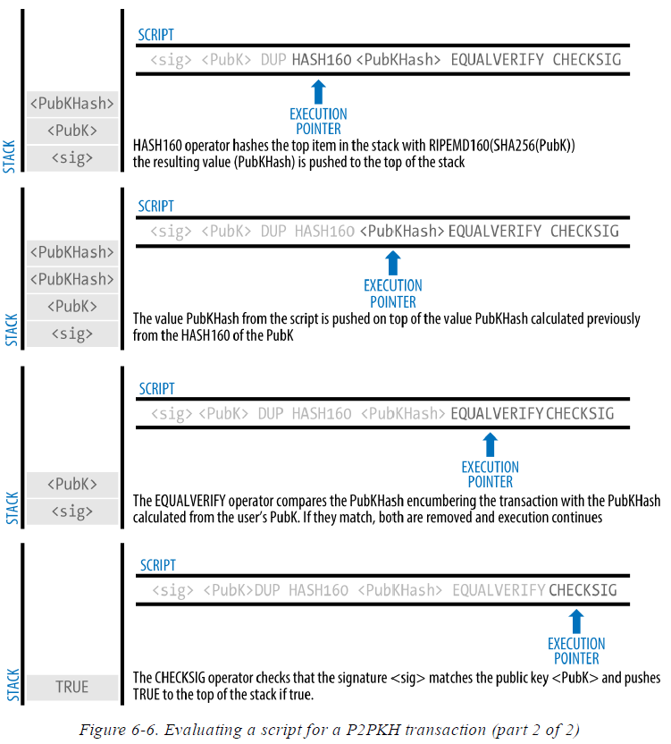
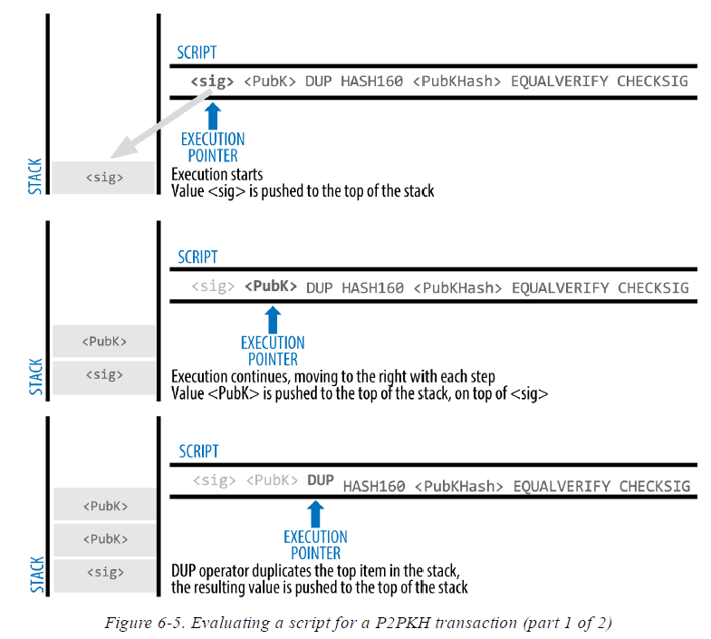
Pay-to-Public-Key-Hash (P2PKH) Script (4/4)
Check public key via hash
Check signature

Slide 24
Digital Signatures (ECDSA)
The digital signature algorithm used in bitcoin is the Elliptic Curve Digital Signature Algorithm (ECDSA) for digital signatures based on elliptic curve private/public key pairs.
ECDSA is used by the script functions OP_CHECKSIG, OP_CHECKSIGVERIFY, OP_CHECKMULTISIG, and OP_CHECKMULTISIGVERIFY. Any time you see those in a locking script, the unlocking script must contain an ECDSA signature.
A digital signature serves three purposes in bitcoin:
It proves that the owner of the private key, who is by implication the owner of the funds, has authorized the spending of those funds.
The proof of authorization is undeniable (nonrepudiation)
It proves that the transaction (or specific parts of the transaction) have not and cannot be modified by anyone after it has been signed.

Slide 25
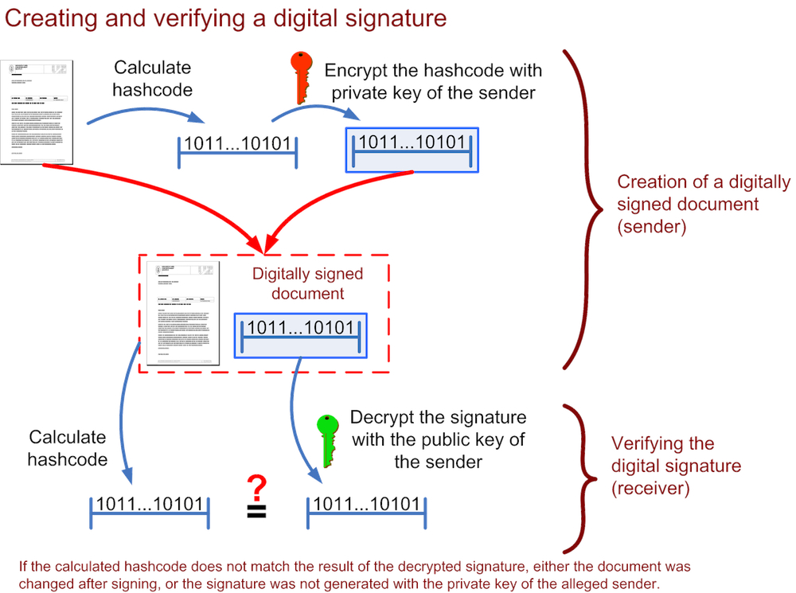
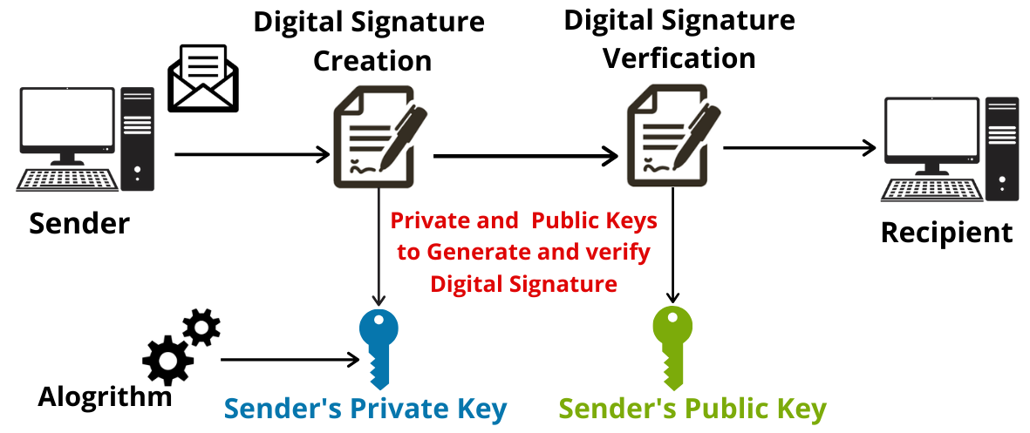
How Digital Signatures Work
A digital signature is a mathematical scheme that consists of 2 parts. The first part is an algorithm for creating a signature, using a private key (the signing key), from a message (the transaction).
The second part is an algorithm that allows anyone to verify the signature, given also the message and a public key.

Slide 26
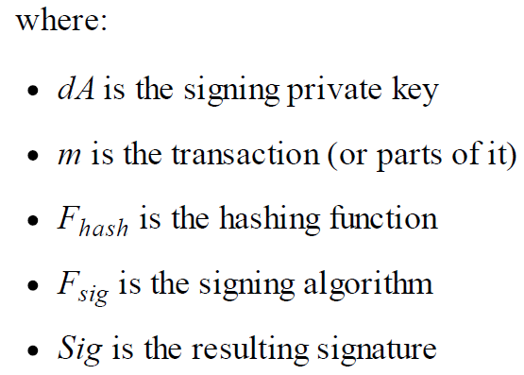

Creating a Digital Signature
In bitcoin’s implementation of the ECDSA algorithm, the “message” being signed is the transaction, or more accurately a hash of a specific subset of the data in the transaction
$$Sig=F_{sig}(F_{hash}\left(m\right), dA)$$
Function F_{sig} produces a signature Sig that is composed of two values, commonly referred to as R and S: Sig = (R, S)

Slide 27
Verifying the Signature
To verify the signature, one must have the signature (R and S), the serialized transaction, and the public key (that corresponds to the private key used to create the signature).
Verification of a signature means “Only the owner of the private key that generated this public key could have produced this signature on this transaction.”
The signature verification algorithm takes the message (a hash of the transaction or parts of it), the signer’s public key and the signature (R and S values), and returns TRUE if the signature is valid for this message and public key.

Slide 28
Signature Hash Types (SIGHASH)
Bitcoin signatures have a way of indicating which part of a transaction’s data is included in the hash signed by the private key using a SIGHASH flag.
Every signature has a SIGHASH flag and the flag can be different from to input to input. A transaction with three signed inputs may have three signatures with different SIGHASH flags, each signature signing (committing) different parts of the transaction.
Note also that bitcoin transactions may contain inputs from different “owners,” who may sign only one input in a partially constructed (and invalid) transaction, collaborating with others to gather all the necessary signatures to make a valid transaction.
Notes:
A signature hash (SIGHASH) flag is a small part of each input in a transaction that determines which parts of the transaction become immutable once a signature has been added to the transaction. A signature signs a hash of data, and thus a signature commits to an exact form of a piece of data.

Slide 29

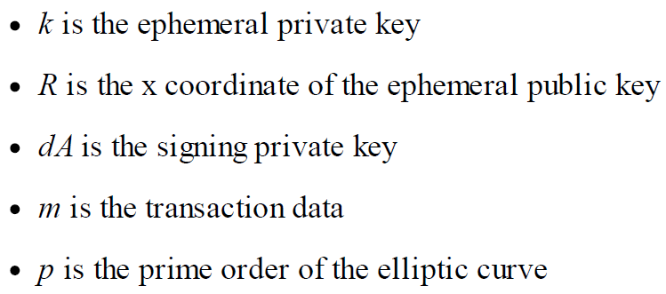
ECDSA Math (1/2)
The signature algorithm first generates an ephemeral (temporary) private public key pair: a random number k as the temporary private key and the corresponding temporary public key P (≠p).
The R value of the digital signature is then the x coordinate of the ephemeral public key P.
The algorithm calculates the S value of the signature:
Complex & difficult to understand!

Slide 30

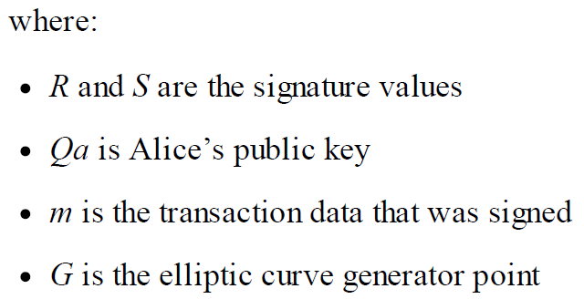
ECDSA Math (2/2)
Verification is the inverse of the signature generation function, using the R, S values and the public key Qa to calculate a value P, which is a point on the elliptic curve.
If x coordinate of the calculated point P is equal to R, then the verifier can conclude that the signature is valid.
(Note that in verifying the signature, the private key dA is neither known nor revealed.)

Slide 31
Importance of Randomness in Signatures
The signature generation algorithm uses a random key k, as the basis for an ephemeral private/public key pair. The value of k is not important, as long as it is random.
If the same value k is used to produce two signatures on different messages (transactions), then the signing private key can be calculated by anyone. Reuse of the same value for k in a signature algorithm leads to exposure of the private key!
This is not just a theoretical possibility. We have seen this issue lead to exposure of private keys in a few different implementations of transaction signing algorithms in bitcoin.

Slide 32
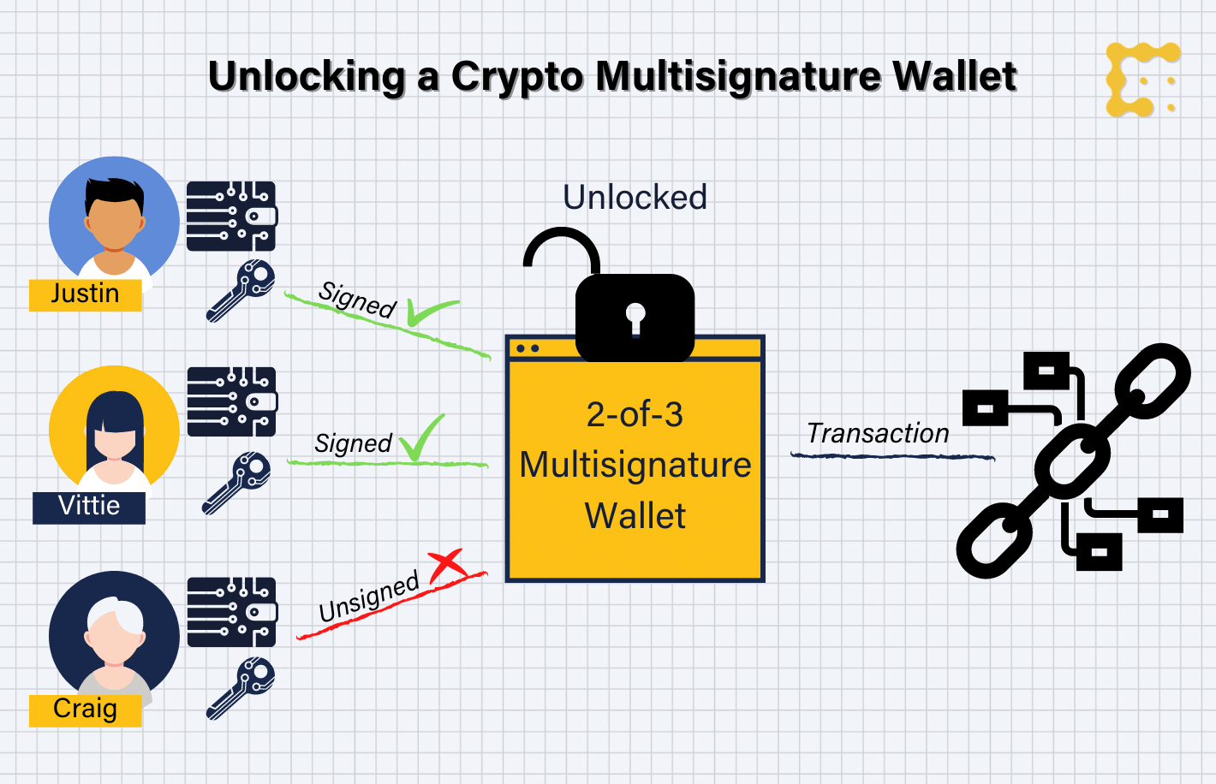
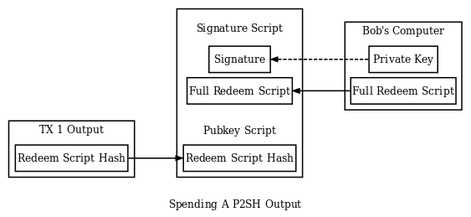
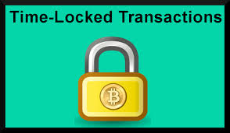
Advanced Transactions and Scripting
Multisignature
Pay-to-Script-Hash
Timelocks
Data Recording Output (RETURN)
Conditional Clauses

Slide 33

Multisignature (1/2)
Multisignature scripts set a condition where N public keys are recorded in the script and at least M of those must provide signatures to unlock the funds. This is also known as an M-of-N scheme.
At this time (from the book), standard multisignature scripts are limited to at most 15 listed public keys
A locking script setting a 2-of-3 multisignature condition looks like this:
The preceding locking script can be satisfied with an unlocking script containing pairs of signatures and public keys:

Slide 34
Multisignature (2/2)
The two scripts together would form the combined validation script:
A bug in CHECKMULTISIG execution
There is a bug in CHECKMULTISIG’s execution that requires a slight workaround. When CHECKMULTISIG executes, it should consume M+N+2 items on the stack as parameters. However, due to the bug, CHECKMULTISIG will pop an extra value or one value more than expected.
Because this bug became part of the consensus rules, it must now be replicated forever. Therefore the correct script validation would look like this:

Slide 35
Pay-to-Script-Hash (P2SH) (1/6)
Pay-to-Script-Hash (P2SH) was introduced in 2012 as a powerful new type of transaction that greatly simplifies the use of complex transaction scripts.
Practical example: Mohammed is an electronics importer based in Dubai. Mohammed’s company uses bitcoin’s multisignature feature extensively for its corporate accounts.
With the multisignature scheme, any payments made by customers are locked in such a way that they require at least two signatures to release, from Mohammed and one of his partners or from his attorney who has a backup key. A multisignature scheme like that offers corporate governance controls and protects against theft, embezzlement, or loss.
The resulting script is quite long and looks like this: (2-of-5)

Slide 36
Pay-to-Script-Hash (P2SH) (2/6)
Although multisignature scripts are a powerful feature, they are cumbersome to use.
Mohammed would have to communicate this script to every customer prior to payment.
Each customer would have to use special bitcoin wallet software with the ability to create custom transaction scripts, and each customer would have to understand how to create a transaction using custom scripts.
Furthermore, the resulting transaction would be about five times larger than a simple payment transaction, because this script contains very long public keys. The burden of that extra-large transaction would be borne by the customer in the form of fees.
Finally, a large transaction script like this would be carried in the UTXO set in RAM in every full node, until it was spent.

Slide 37
Pay-to-Script-Hash (P2SH) (3/6)
P2SH was developed to resolve these practical difficulties and to make the use of complex scripts as easy as a payment to a bitcoin address.
With P2SH payments, the complex locking script is replaced with its digital fingerprint, a cryptographic hash.
When a transaction attempting to spend the UTXO is presented later, it must contain the script that matches the hash, in addition to the unlocking script.
In simple terms, P2SH means “pay to a script matching this hash, a script that will be presented later when this output is spent.”
In P2SH transactions, the locking script that is replaced by a hash is referred to as the redeem script because it is presented to the system at redemption time rather than as a locking script.

Slide 38
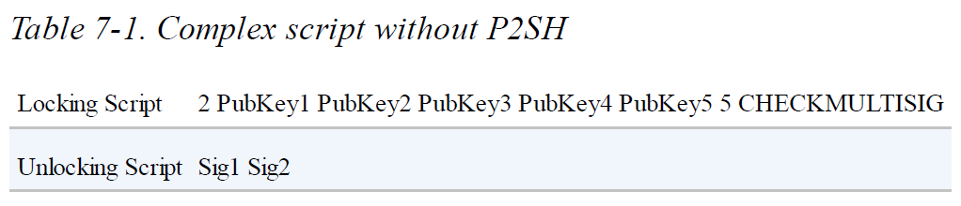
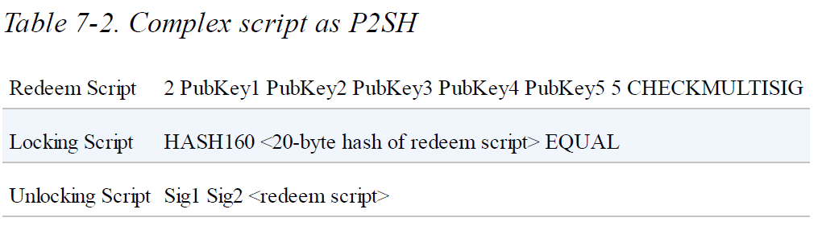
Pay-to-Script-Hash (P2SH) (4/6)

Slide 39
Pay-to-Script-Hash (P2SH) (5/6)
P2SH Addresses
Another important part of the P2SH feature is the ability to encode a script hash as an address, as defined in BIP-13. P2SH addresses are Base58Check encodings of the 20-byte hash of a script, just like bitcoin addresses are Base58Check encodings of the 20-byte hash of a public key.
P2SH addresses use the version prefix “5,” which results in Base58Check-encoded addresses that start with a “3.”
P2SH addresses hide all of the complexity, so that the person making a payment does not see the script.
Benefits of P2SH
Complex scripts are replaced by shorter fingerprints in the transaction output, making the transaction smaller.

Slide 40
Pay-to-Script-Hash (P2SH) (6/6)
Scripts can be coded as an address, so the sender and the sender’s wallet don’t need complex engineering to implement P2SH.
P2SH shifts the burden of constructing the script to the recipient, not the sender.
P2SH shifts the burden in data storage for the long script from the output (which is in the UTXO set) to the input (stored on the blockchain).
P2SH shifts the burden in data storage for the long script from the present time (payment) to a future time (when it is spent).
P2SH shifts the transaction fee cost of a long script from the sender to the recipient, who has to include the long redeem script to spend it.
Warning !
A P2SH transaction will be considered valid and accepted even if the redeem script is invalid. You might accidentally lock bitcoin in such a way that it cannot later be spent.

Slide 41
Spending a P2SH Output
Used in the script
Same Hash

Slide 42
Data Recording Output (RETURN) (1/3)
Many developers have tried to use the transaction scripting language to take advantage of the security and resilience of the system for applications such as digital notary services, stock certificates, and smart contracts.
Early attempts to use bitcoin’s script language for these purposes involved creating transaction outputs that recorded data on the blockchain. E.g., to record a digital fingerprint of a file in such a way that anyone could establish proof-of-existence of that file on a specific date by reference to that transaction.
The use of bitcoin’s blockchain to store data unrelated to bitcoin payments is controversial. Those who object to the inclusion of nonpayment data argue that it causes “blockchain bloat,” burdening those running full bitcoin nodes with carrying the cost of disk storage for data that the blockchain was not intended to carry.

Slide 43
Data Recording Output (RETURN) (2/3)
Moreover, such transactions create UTXO that cannot be spent, using the destination bitcoin address as a free form 20-byte field.
Because the address is used for data, it doesn’t correspond to a private key and the resulting UTXO can never be spent; it’s a fake payment.
These transactions that can never be spent are therefore never removed from the UTXO set and cause the size of the UTXO database to forever increase, or “bloat.”
Compromise was reached with introduction of the RETURN operator.
RETURN allows developers to add 80 bytes of nonpayment data to a transaction output.
However, unlike the use of “fake” UTXO, the RETURN operator creates an explicitly provably unspendable output, which does not need to be stored in the UTXO set.

Slide 44
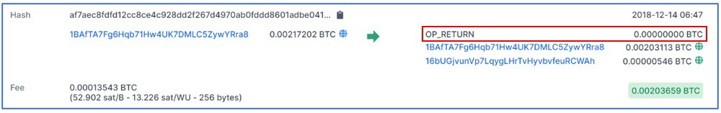
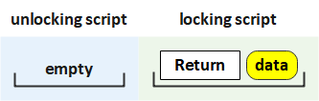
Data Recording Output (RETURN) (3/3)
RETURN outputs are recorded on the blockchain, so they consume disk space and contribute to the increase in the blockchain’s size, but they are not stored in the UTXO set and therefore do not bloat the UTXO memory pool and burden full nodes with the cost of more expensive RAM.
The opcode ‘return’ makes this transaction output unlockable or unspendable. RETURN is usually an output with a zero bitcoin amount.

Slide 45
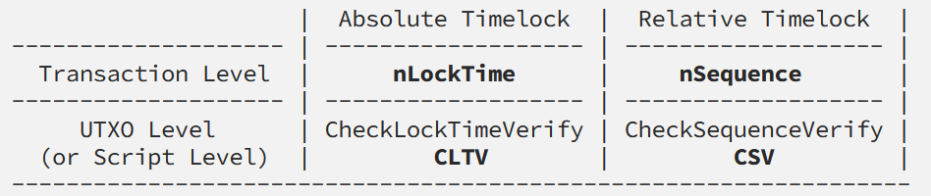

Timelocks (1/5)
Timelocks are restrictions on transactions or outputs that only allow spending after a point in time. Timelocks are useful for postdating transactions and locking funds to a date in the future.
More importantly, timelocks extend bitcoin scripting into the dimension of time, opening the door for complex multistep smart contracts.
Absolute Timelocks: nLocktime, CheckLockTimeVerify (CLTV)
Relative Timelocks: nSequence, CheckSequenceVerify (CSV)

Slide 46
Timelocks (2/5)
nLocktime
It is a type of full time lock that acts on transactions. It was the first one created and the one available in Satoshi Nakamoto’s original Bitcoin software.
It specifies the earliest time in UNIX time – or milliseconds elapsed since midnight on January 1, 1970, so each day is treated as having 86400 seconds – or the lowest block height at which a transaction can be added to a valid block.
It has the limitation that while it makes it possible to spend some outputs in the future, it does not make it impossible to spend them until that time.
E.g. Alice signs a transaction spending one of her outputs to Bob’s address, and sets the transaction nLocktime to 3 months in the future. Alice sends that transaction to Bob to hold.

Slide 47
Timelocks (3/5)
With this transaction Alice and Bob know that: Bob cannot transmit the transaction to redeem the funds until 3 months have elapsed. Bob may transmit the transaction after 3 months.
However, Alice can create another transaction, double-spending the same inputs without a locktime. Thus, Alice can spend the same UTXO before the 3 months have elapsed. Bob has no guarantee that Alice won’t do that.
The only guarantee is that Bob will not be able to redeem it before 3 months have elapsed. There is no guarantee that Bob will get the funds.
To achieve such a guarantee, the timelock restriction must be placed on the UTXO itself and be part of the locking script, rather than on the transaction. This is achieved by the next form of timelock, called CLTV.

Slide 48
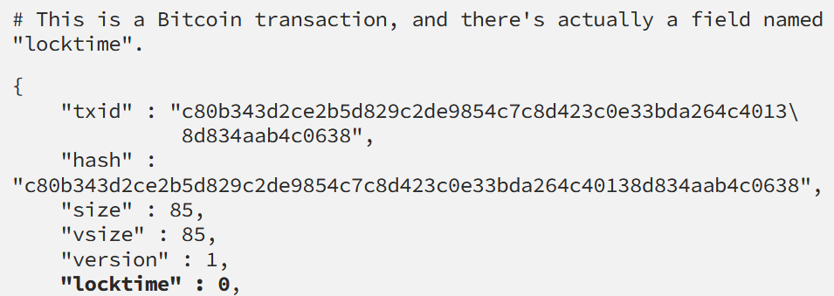
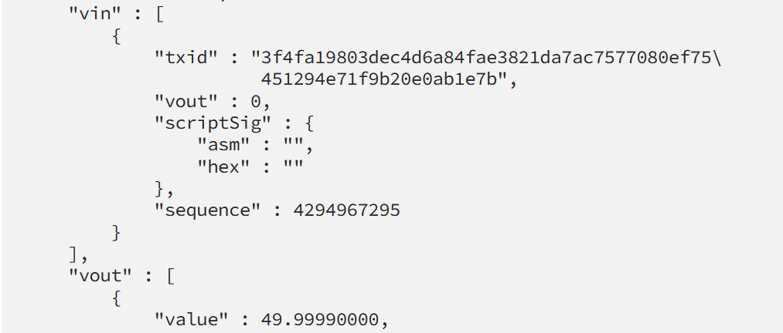
Ref. Sample Transaction with nLockTime
https://medium.com/@RobinHung/bitcoin-timelocks-in-a-nutshell-4c95aafc7a59
nLockTime set to 0 means that the transaction can be added into a block and be appended to the blockchain immediately.

Slide 49
Timelocks (4/5)
CheckLockTimeVerify (CLTV)
In December 2015, CLTV was introduced to bitcoin as a soft fork upgrade. Based on BIP-65, CLTV acts at the script level and locks transaction outputs so that they cannot be spent before a certain time/date. This allows for much greater flexibility in the way timelocks are applied.
In simple terms, by adding the CLTV opcode in the redeem script of an output it restricts the output, so that it can only be spent after the specified time has elapsed.
CLTV doesn’t replace nLocktime, but rather restricts specific UTXO such that they can only be spent in a future transaction with nLocktime set to a greater or equal value.

Slide 50
Timelocks (5/5)
Relative timelocks, like absolute timelocks, are implemented with both a transaction-level feature and a script-level opcode.
The transaction-level relative timelock is implemented as a consensus rule on the value of nSequence, a transaction field set in every transaction input.
Script level relative timelocks are implemented with the CheckSequenceVerify (CSV) opcode (defined in BIP-112).
Consensus rules of the nSequence value are defined in BIP-68.
Transaction inputs with nSequence values less than 2³¹ are interpreted as having a relative timelock.
E.g., a transaction with one input with an nSequence relative timelock of 30 blocks is only valid when at least 30 blocks have elapsed from the time the UTXO referenced in the input was mined.

Slide 51
Scripts with Flow Control (1/2)
One of the more powerful features of Bitcoin Script is flow control, also known as conditional clauses. You are probably familiar with flow control in various programming languages that use the construct IF…THEN…ELSE. Bitcoin conditional clauses look a bit different, but are essentially the same construct.
At a basic level, bitcoin conditional opcodes allow us to construct a redeem script that has two ways of being unlocked, depending on a TRUE/FALSE outcome of evaluating a logical condition. For example, if x is TRUE, the redeem script is A and the ELSE redeem script is B.
Additionally, conditional expressions can be “nested” indefinitely.

Slide 52
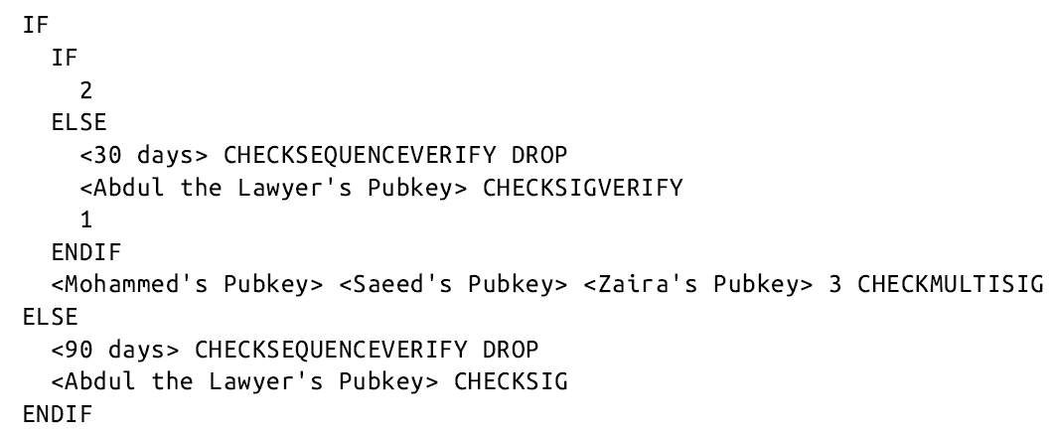
Scripts with Flow Control (2/2)
Another form of conditional in Bitcoin Script is any opcode that ends in VERIFY. The VERIFY suffix means that if the condition evaluated is not TRUE, execution of the script terminates immediately and the transaction is deemed invalid.
(Example on P.225 in the book)

